Slide 1
Industry Use Case: Smart Product Labeling and Traceability System for Quality Control Automation
Intel Unnati Industrial Training Program - 2025

Slide 2
Problem Statement
In current manufacturing environments (electronics, medical devices, automotive), labeling systems are often semi-automated and disconnected from quality checks. This results in labeling errors and non-compliance with regulatory or logistical standards. There is a need for an automated, intelligent labeling and traceability system that ensures label accuracy and product verification using real-time data.

Slide 3
Unique Idea Brief (Solution)
The Smart Product Labeling and Traceability System integrates sensor-based inspection, AI-powered label verification, and actuator-based labeling/rejection mechanisms to ensure accurate labeling. It automates the end-to-end labeling process, validating compliance and logging traceability data for quality control.

Slide 4
Features Offered
Real-time inspection and compliance verification Automated label printing or validation (QR/Barcode) OCR/ML integration for defect detection Label rejection mechanism for faulty/mismatched products Traceability database logging Simulated or hardware implementation

Slide 5
Process flow
Product arrives on conveyor Identification via sensor/camera Compliance check (RoHS, Batch ID, Device ID, Mfg Date) Label generation or verification Apply/validate label using actuator Reject if data is missing/incorrect Store inspection data to traceability log

Slide 6
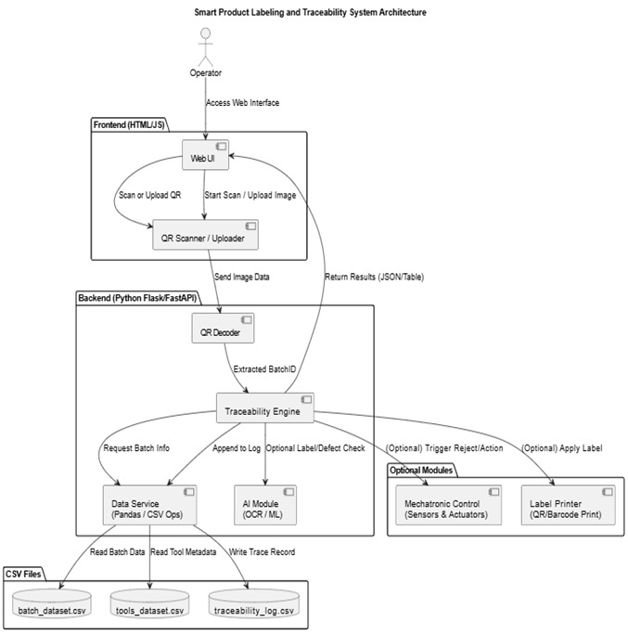
Architecture Diagram

Slide 7
Technologies used
Next.js Radix UI Tailwind CSS Node.js 22.17.0 pnpm 10.12.4

Slide 8
Team members and contribution:
Bochkar Nikhith – AI Model Integration (OCR, ML) Banisetty Janeshwar Rao – Control Logic & Simulation Jakkireddy Sri Charan Reddy – Traceability Database Design & Integration

Slide 9
Conclusion
The proposed system bridges the gap between labeling and quality control by combining mechatronics and AI. It ensures label accuracy, enhances traceability, and supports compliance in automated manufacturing environments. Scalable and adaptable for real-world industrial use.

